Slide 1


Vivekananda College of Engineering & Technology
[A Unit of Vivekananda Vidyavardhaka Sangha Puttur®]
Affiliated to Visvesvaraya Technological University
Approved by AICTE New Delhi & Recognised by Govt of Karnataka
DEPARTMENT OF COMPUTER SCIENCE AND ENGINEERING ( DATA SCIENCE )
Project Phase I Synopsis Presentation on
Web-Based Automatic Timetable Scheduler for Schools & Colleges
Presented by : Gaurav G Alva
4VP22CD019
Harshit M Naik
4VP22CD022
Prapthi J P
4VP22CD037
Supreetha N S
4VP22CD058
Guided by : Prof. Chaithanya D

Slide 2
Introduction
Web-based Automatic timetable Scheduler for schools and colleges, eliminating the need for manual scheduling. It ensures efficient allocation of subjects, faculty, and classrooms while avoiding conflicts and reducing human effort. The system provides a user-friendly web interface where administrators can input details, and the algorithm takes care of scheduling.
This is a NP-Hard Problem where the exact solution cannot be determined thus the project uses the Genetic Algorithm (GA) to optimize timetables by generating multiple scheduling options, evaluating them for conflicts, and improving them through selection, crossover, and mutation. The process continues until the best possible timetable is achieved, ensuring a balanced, conflict-free, and efficient schedule for all stakeholders.

Slide 3
Problem Statement
Timetable scheduling is an NP-Hard combinatorial optimization problem faced by educational institutions. The challenge involves allocating courses, instructors, students, and classrooms to specific time slots while adhering to multiple constraints.
The traditional manual approach to timetable generation is time-consuming, error-prone, and often leads to scheduling conflicts.

Slide 4
Existing solution
Timetables are manually created by coordinators, requiring significant time and effort to ensure proper scheduling. Coordinators must carefully analyse multiple factors to prevent conflicts such as overlapping lectures, faculty unavailability and limited classroom resources, making the process prone to errors.
The automation techniques do not prove efficient as they are not able to satisfy the constraints where the same faculty member is allotted with continuous classes

Slide 5
Proposed Solution
The proposed solution utilizes a Genetic Algorithm (GA) for automatic timetable generation. GA mimics natural selection principles to evolve an optimal timetable by iteratively improving solution. This method ensures:
Minimized timetable conflicts.
Optimal utilization of resources (classrooms, faculty, and time slots).
Reduction in human intervention and errors.

Slide 6
Requirements
System Requirements:
PC should have at least 4 GB of RAM,
Windows 7 and upwards.
Python version least 3.8 or above.
SQLite default database.
Internet access.
Project Components:
Identifying the requirements of the institution.
Details about the Faculty, Courses, Classes, Classrooms, Labs.
Customization of timetable as per the requirements.

Slide 7
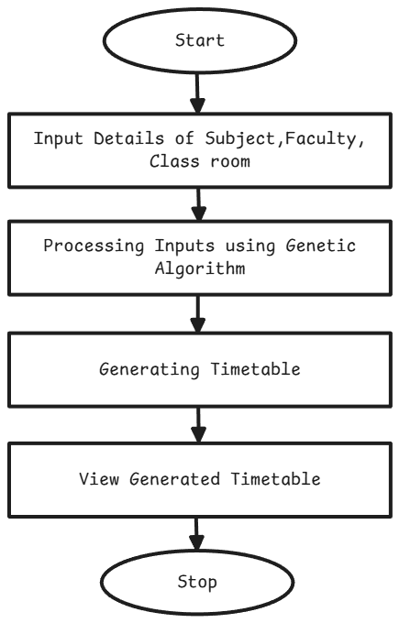
Flow Chart
Figure : The flowchart visually represents the automated timetable generation process using a Genetic Algorithm.

Slide 8
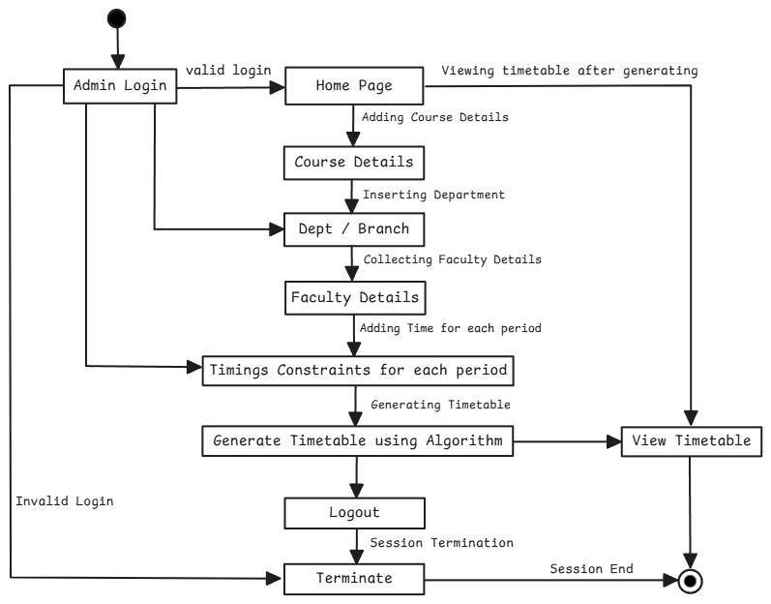
Activity Diagram
Figure : The activity diagram provides a detailed workflow of the web-based timetable scheduling system, focusing on user interactions and system functions.

Slide 9
Methodology
Design and Development:
User friendly interface for timetable generation.
Using basic HTML, CSS and Django and other PyPi libraries for development.
Integration of Email for User account creation.
Deployment:
Deploying the System in the Server / Cloud platform (AWS or Google Cloud).
GitHub for managing the Code.

Slide 10
Genetic Algorithm
Genetic algorithms are commonly used to generate high-quality solutions to optimization and search problems via biologically inspired operators such as selection, crossover, and mutation.
Creating Random Timetables – The system first creates many random timetable options.
Checking for Mistakes – It examines each timetable to see if there are any clashes, like a teacher being assigned to two classes at the same time.
Picking the Best Ones – The system selects the best schedules that have fewer mistakes.
“Selects the best, rejects the rest”
Mixing and Matching – It takes the best schedules and combines them to create even better ones.
Making Small Changes – Tiny changes are made to improve the timetable further.
Repeating the Process – This cycle continues until the system finds the most perfect timetable possible.
*Introduction to Genetic algorithm by R K Bhattachariya/CE/IIT Guwahati

Slide 11
Conclusion
As discussed, an evolutionary algorithm, genetics algorithm for time tabling has been proposed. The intention of the algorithm to generate a time-table schedule automatically is satisfied. The algorithm incorporates a number of techniques, aimed to improve the efficiency of the search operation. By automating this process with the help of computer assistance timetable generator can save a lot of precious time of administrators who are involved in creating and managing various timetables of the institute.
This reduces time consumption and the error in framing the timetable manually. The benefits of this approach are simplified design and reduced development time.

Slide 12
References
Mittal, Dipesh, Hiral Doshi, Mohammed Sunasra, and Renuka Nagpure. "Automatic timetable generation using genetic algorithm." International Journal of Advanced Research in Computer and Communication Engineering 4, no. 2 (2015): 245-248.
Abdelhalim, Esraa A., and Ghada A. El Khayat. "A utilization-based genetic algorithm for solving the university timetabling problem (UGA)." Alexandria Engineering Journal 55, no. 2 (2016): 1395-1409.
Prabhakaran, Bhavadharani Swaminadhan, Maheswari Shanmugam, Chaaru Bhala Karunakaran, Bhumika Murugesan, and Deepalakshmi Manimaran. "Automatic Timetable Generator Using Genetic Algorithm." In 6th International Conference on Intelligent Computing (ICIC-6 2023), pp. 84-89. Atlantis Press, 2023.

